Slide 1
Job Trend Analysis: Insights & Impacts
April 26, 2025

Slide 2
Agenda
Executive Summary: Job Trend Analysis
Why Job Trend Analysis Matters
Project Goals and Stakeholders
Data Sources and Methodology
Snapshot of the Dataset
Key Findings: Growing Job Roles
Emerging Opportunities Across Sectors
In-Demand Skills: What Employers Seek
Skill Frequency in Job Postings
The Role of Soft Skills
Salary Trends by Job Role
Salary Distribution and Career Progression
Clustering Insights: Machine Learning Analysis
Visualization of Job Role Clusters
Conclusions: Key Takeaways
Preparing for the Future Workforce
Empowering Your Career with Trends

Slide 3

Executive Summary: Job Trend Analysis
Overview
Customize the executive summary with specific regional or industry data relevant to your audience to increase engagement and relevance.
This analysis explores the evolving job landscape shaped by technological advances and economic shifts. It identifies growing roles, key skills employers seek, and salary trends, providing insights for individuals and organizations to align strategies with future workforce demands.
Growing Roles and Market Trends
In-Demand Skills and Salary Insights
The job market is rapidly evolving with technology-driven roles leading growth, especially Data Scientist and Data Engineer positions. Key in-demand skills include Excel, Python, and cloud technologies. High salaries reflect strong demand across data roles, while continuous learning and collaboration among stakeholders are essential to prepare for future workforce needs.
Data Scientist and Data Engineer roles are the fastest growing in tech, with Data Scientists projected to grow by 36% this decade, reflecting widespread adoption of data-driven strategies.
Emerging roles such as AI specialists, information security analysts, and rapidly expanding healthcare and green energy jobs demonstrate growth beyond traditional tech sectors.
Technology acts as a catalyst across industries, driving job creation in diverse fields including healthcare and renewable energy.
The diversity in high-growth roles underscores the importance of cross-sector adaptability and continuous skill development to meet evolving market needs.
Excel remains the most frequently required skill, appearing in 64% of job postings, highlighting the enduring importance of fundamental data handling abilities.
Python leads among programming languages demanded by employers, with cloud platforms like AWS and big data tools such as Spark also highly sought after.
Advanced roles command premium salaries averaging around $220K, nearly double that of Data Analyst roles, indicating the value placed on specialized technical expertise.
Soft skills such as communication and adaptability complement technical skills, enhancing employability and effectiveness in data roles.

Slide 4
Why Job Trend Analysis Matters
Importance
Guiding Career Choices
Customize this slide by adding specific examples of job trends relevant to your audience's region or industry to make the content more actionable.
Job trend analysis helps students and job seekers identify growing fields and essential skills, enabling informed decisions about education and career paths.
Supporting Business Strategy
Businesses use job trend data to anticipate workforce needs, address skill gaps, and stay competitive by aligning hiring and training with market demands.
Shaping Education and Policy
Educators update curricula based on emerging skills, while policymakers design relevant training and education programs to prepare the workforce for future challenges.

Slide 5
Project Goals and Stakeholders
Goals
Project Goals
Benefits for Students & Job Seekers
Customize this slide by adding specific examples of skills or roles relevant to your audience's region or industry to increase engagement.
Predict high-growth career paths within data and tech sectors based on market trends and job data analysis.
Identify the most sought-after technical skills and competencies employers require in emerging roles.
Provide actionable insights to help students, professionals, companies, and educators prepare effectively for future job market demands.
Gain clarity on which skills and roles offer growing opportunities in the data job market.
Make informed career decisions and prioritize learning relevant, in-demand technical and soft skills.
Navigate career paths with awareness of salary trends and industry expectations.
This project aims to identify high-growth job roles and in-demand skills in the evolving data-driven job market, empowering students, employers, educators, and policymakers to make informed decisions. Understanding the goals and key beneficiaries ensures targeted preparation for future workforce needs.
Benefits for Employers & Educators
Benefits for Policymakers
Anticipate talent needs and identify skill gaps to refine hiring and training strategies.
Align educational curricula with evolving market requirements, integrating emerging technologies like data analytics and cloud computing.
Support workforce development by fostering relevant competencies in current and future employees.
Design workforce training programs targeting high-growth sectors to maximize employment outcomes.
Inform education policies that promote STEM and tech skills aligned with industry evolution.
Enable data-driven decision-making to support economic growth and labor market resilience.

Slide 6
Data Sources and Methodology
Methodology
Data Sources
Glassdoor Salary Data from Kaggle provided extensive salary estimates and company/job metadata for data roles.
Live job listings were scraped from Workable and Apify platforms, focusing on Data Analyst, Data Scientist, and Data Engineer positions for current market demands.
Dataset combined over 1,100 job entries after cleaning and merging these sources to ensure accuracy and relevance.
Data fields included job titles, companies, average salaries, required skills like Python and Excel, and job categories for comprehensive analysis.
Highlight any unique or proprietary data sources you may have used to enhance credibility.
Data Preparation and Cleaning
Raw data from different sources was cleaned to remove duplicates, irrelevant postings, and inconsistent entries.
Standardization of job titles and skill keywords ensured uniformity across datasets for accurate comparison.
Missing salary data was handled carefully to maintain dataset integrity without biasing results.
Merged dataset allowed cross-referencing skills requirements with salary ranges and job roles for deeper insights.
Our analysis combined multiple reliable data sources and applied rigorous cleaning and clustering techniques to uncover meaningful job market trends. This comprehensive approach ensured up-to-date insights into skills demand, salary patterns, and role distinctions for data-related jobs.
Analytical Approaches
Unsupervised machine learning techniques clustered job postings by skill patterns and salary to identify distinct role groups.
Frequency analysis was used to determine the most demanded technical skills appearing in job listings.
Salary trend analysis compared average and distribution of pay across job roles, highlighting career progression.
Qualitative review of job descriptions supplemented quantitative data, especially for identifying soft skills and emerging trends.

Slide 7


Snapshot of the Dataset
Dataset Overview
Dataset Composition and Sources
Over 1,100 job listings focused on data roles such as Data Analyst, Scientist, and Engineer.
Data merged from Glassdoor salary data and live job listings from Workable/Apify.
Includes detailed fields: company name, job title, category, average salary, and skill requirements.
Data cleaned and standardized to ensure accurate, comparable analysis.
Add a visual sample or table excerpt of your actual dataset to increase audience engagement and clarity.
Key Data Fields and Features
Job titles categorized by role and industry sector.
Salary estimates accompanying each job posting for compensation analysis.
Skill indicators marking demand for technologies like Python, Excel, AWS, Spark.
Combination of historical salary data and live skill mentions for current market relevance.

Slide 8
Key Findings: Growing Job Roles
Job Roles
Customize the metrics by adding specific job growth percentages relevant to your target audience's region or industry to enhance relevance.
36
Data Scientist Jobs
35
Data Engineer Jobs
46
Data Analyst

Slide 9

Emerging Opportunities Across Sectors
Opportunities
Highlight specific roles and growth rates in sectors relevant to your audience to make the content more actionable and relatable.
Technology and Data Expansion
Roles such as AI/Machine Learning Specialists and Information Security Analysts are rapidly growing, driven by widespread adoption of data-driven strategies across industries.
Healthcare Sector Growth
Healthcare roles like Nurse Practitioners are expanding by over 40%, fueled by aging populations and advances in medical technology requiring skilled professionals.
Clean Energy and Education
Green energy jobs (e.g., Wind Turbine Technicians) are growing at over 50%, while educational roles are rising to support workforce upskilling and continuous learning needs.

Slide 10
In-Demand Skills: What Employers Seek
Skills
Include specific examples of how these skills apply to your audience's industry to increase relevance.
Frequency of Key Skills in Job Postings
Analysis and Recommendations
Excel is required in approximately 64% of job listings, highlighting its enduring importance for data handling and analysis.
Python dominates programming requirements, appearing in about 39% of postings, signaling its status as the preferred language for data roles.
Cloud and big data technologies like AWS and Spark each appear in roughly 15% of listings, indicating growing demand for skills in large-scale data processing and cloud infrastructure.
R is rarely mentioned, suggesting a decreased emphasis on this language in current data job markets compared to Python.

Slide 11
Skill Frequency in Job Postings
In-Demand Skills
Excel’s dominance shows fundamental data handling is critical, while Python’s strong presence reflects its leading role in data programming.
Highlight skills most relevant to your audience's region or industry by adjusting the skill list and data source.
Frequency of Key Skills Mentioned in Data Job Postings

Slide 12

The Role of Soft Skills
Soft Skills
Beyond technical expertise, soft skills are critical in data roles.
Effective communication enables professionals to translate complex data insights into clear, actionable recommendations.
Problem-solving skills help navigate unstructured challenges and innovate solutions.
Adaptability ensures continuous learning and responsiveness to evolving tools and business needs.
These interpersonal and cognitive abilities enhance teamwork, decision-making, and overall job performance.

Slide 13
Salary Trends by Job Role
Salary Insights
Customize by adding salary ranges or regional salary differences to offer more detailed insights for your audience.
Average Salary by Data Job Role
119K
Data Analyst avg. salary
219K
Data Scientist avg. salary
219K
Data Engineer avg. salary

Slide 14
Salary Distribution and Career Progression
Compensation
Customize this slide by including salary data specific to your region or industry to make it more relevant to your audience.
Salary levels within data roles vary significantly, reflecting career progression and specialization. Entry-level analyst positions start lower but progress to highly compensated technical roles like Data Scientists and Engineers. Understanding this distribution helps guide career development and expectations.
Salary Distribution Across Roles
Data Analysts generally earn between $50K and $120K, reflecting entry to mid-level positions.
Data Scientists and Data Engineers command higher salaries, averaging around $219K, with some senior roles exceeding $250K.
There is a wide salary range due to factors such as geographic location, company size, and industry sector.
Higher salaries correlate with advanced technical skills like machine learning, big data tools, and cloud computing expertise.
Internships and junior analyst roles tend to fall at the lower end of the salary spectrum, emphasizing growth potential.
Career Progression Insights
Starting as a Data Analyst provides foundational skills in data handling and reporting, often using Excel and basic analytics.
Progression typically involves gaining programming skills (Python, R) and knowledge of cloud and big data platforms (AWS, Spark).
Advanced roles such as Data Scientist or Data Engineer require deeper technical expertise and command significantly higher compensation.
Career advancement is marked by increasing responsibility, specialized knowledge, and the ability to solve complex problems.
Continuous learning and upskilling are essential to move from analyst to technical expert roles and maximize earning potential.

Slide 15
Clustering Insights: Machine Learning Analysis
Analysis
Customize this slide by including specific clustering algorithm names or metrics used in your analysis for a more technical audience.
Distinct Role Clusters
Skill Profile Differences
Visualization of Clusters
Machine learning grouped job postings into clusters aligning with expected job types: one cluster for Data Analysts characterized by Excel skills, and another for Data Scientists/Engineers marked by programming and cloud expertise.
Analyst roles focus on Excel with minimal coding, reflecting entry-level job nature and lower salaries. Scientist/Engineer roles demand Python, AWS, and Spark skills, and offer higher pay due to their technical complexity.
A PCA plot clearly separates postings heavy in Excel from those requiring programming, reinforcing that data jobs split into fundamental data handling versus advanced data processing career tracks.

Slide 16
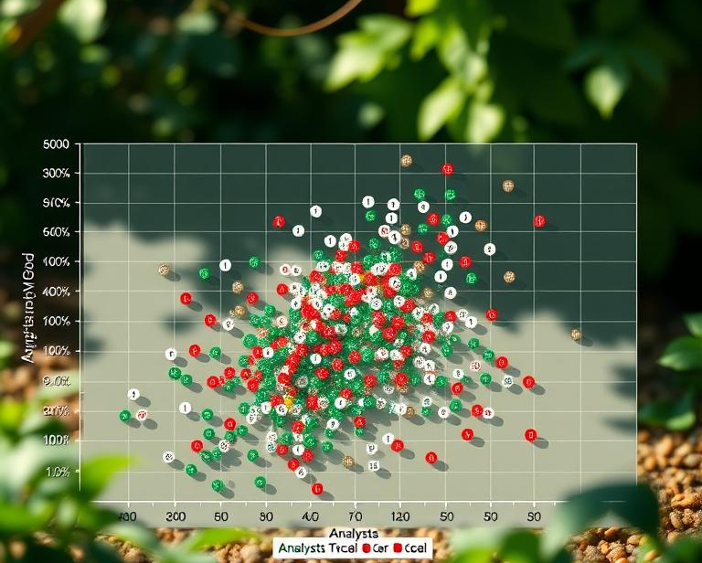
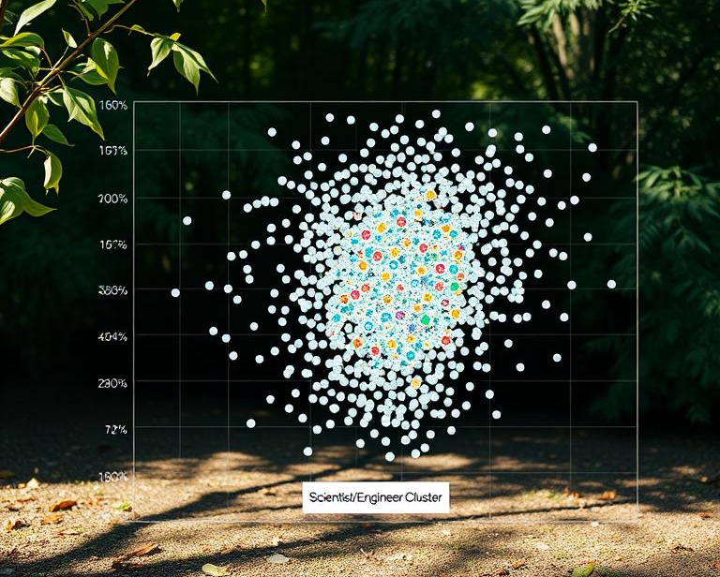
Visualization of Job Role Clusters
Clustering
Analyst Cluster Characteristics
Use actual data visualizations like PCA or t-SNE plots from your analysis to make the clusters visually clear and engaging.
This cluster groups data analyst roles characterized by heavy reliance on Excel and lower coding requirements, reflecting operational and entry-level positions with moderate salaries.
Scientist/Engineer Cluster Features
This cluster includes data scientist and engineer roles marked by strong programming skills in Python, AWS, and Spark, associated with higher salaries and advanced technical expertise.

Slide 17
Conclusions: Key Takeaways
Conclusions
01
Digital Skills Drive Careers
Proficiency in Python, cloud platforms, and Excel is critical. Combining technical expertise with communication and adaptability creates the best opportunities.
Tailor the examples of high-growth sectors or skills to match your audience's industry or region for greater relevance.
02
High-Growth Sectors
Tech & data roles grow rapidly (~30%+), healthcare expands with aging populations (+46%), education focuses on upskilling, and clean energy surges (+50-60%).
03
Lifelong Learning is Essential
Technology constantly evolves, requiring continuous skill updates. Embracing new tools and adapting to change ensures career resilience and relevance.
04
Collaboration is Key
Educators, companies, and governments must work together to address skill gaps, update programs, invest in training, and support accessible education.

Slide 18



Preparing for the Future Workforce
Workforce
Include examples of successful collaborations between schools, businesses, and governments to illustrate effective workforce preparation strategies.
Educators Aligning with Industry
Corporate Investment in Training
Policy Support for Workforce Development
Educational institutions should partner with companies to update curricula, integrating emerging skills like data literacy, cloud computing, and AI to prepare students for future roles.
Companies must invest in ongoing employee training and upskilling programs rather than relying solely on hiring, ensuring their workforce adapts to technological advances and market shifts.
Governments and institutions should support accessible education initiatives and workforce development programs focused on high-demand skills, fostering inclusive growth and addressing talent shortages.

Slide 19

Conclusion
Staying informed about job trends equips you to navigate and seize future career opportunities confidently.
Tailor this slide by adding examples of emerging roles or skills specific to your audience's industry to make the empowerment message more relatable.

